Slide 1
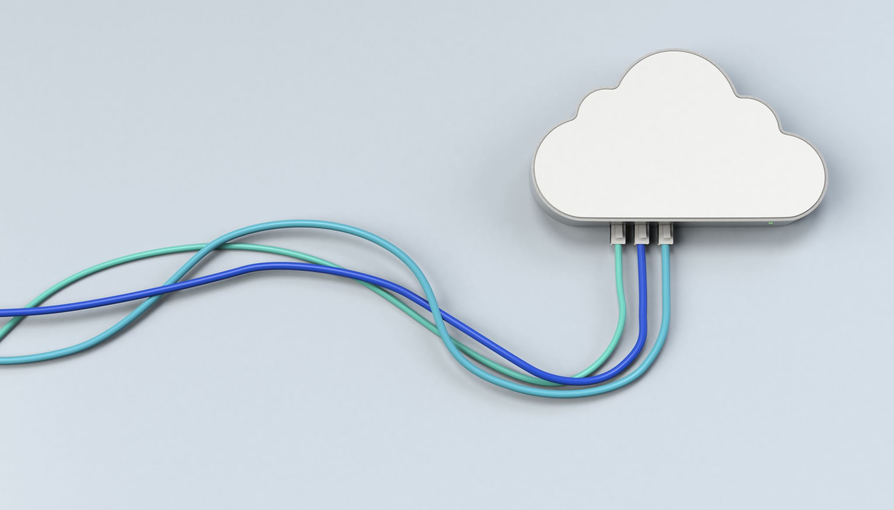
WK 02 - Cloud Computing
PPOL 5206
Spring 2025

Slide 2

Objectives
What is the cloud?
History
Definitions
Cloud Providers
Cloud Services
Lab

Slide 3
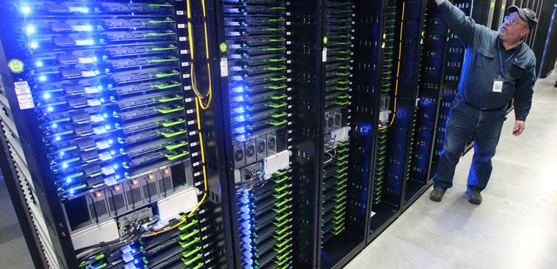
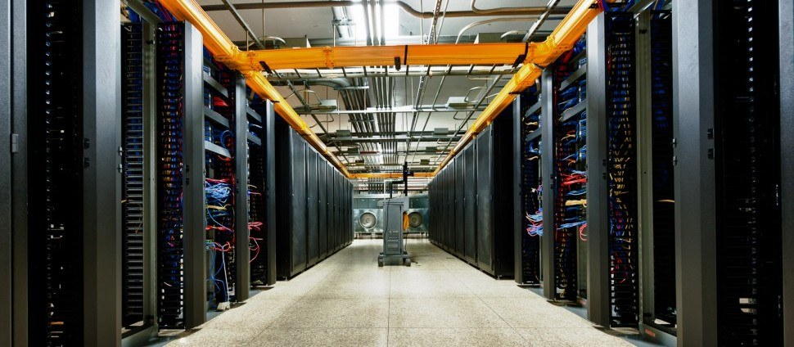
Is it JUST Someone Else’s Computer?

Slide 4
What is the “Cloud”?
Scalable software and services that are accessed via the internet, rather than on your local machine.

Slide 5
History of the Cloud
Technological advances and increased efficiencies

Slide 6
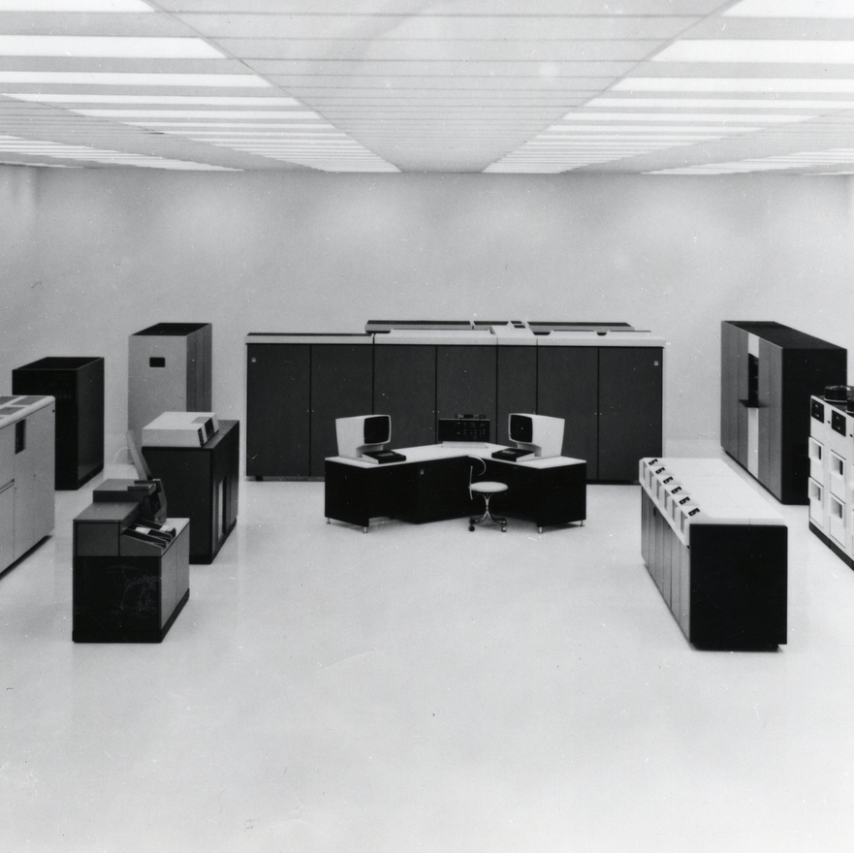
Mainframes
Time sharing
Access via terminals
Image: IBM 3033 Mainframe Computer, By Norsk Teknisk Museum - https://digitaltmuseum.org/011015240038/22-0-ibm-modell-3000-30xx, CC BY-SA 3.0, https://commons.wikimedia.org/w/index.php?curid=110829222

Slide 7

Virtualization
Virtualization allows multiple virtual machines (VMs) to run on a single physical server by abstracting computing resources.
Benefits include:
Resource Optimization: Utilizes CPU, memory, and storage more efficiently.
Cost Savings: Reduces the need for additional physical hardware.
Scalability: Can quickly allocate resources to new VMs.
Isolation: One VM failure does not affect others on the same physical machine.

Slide 8
Hypervisors
A hypervisor is software that creates and manages VMs, ensuring they operate independently.
Allocates hardware resources dynamically.
Type 1 (Bare Metal Hypervisor)
Installed directly on hardware (no underlying OS).
Pros: High performance, low latency, better security.
Used in enterprise data centers & cloud platforms
Type 2 (Hosted Hypervisor)
Runs on top of an OS (Windows/Linux/Mac).
Pros: Easier setup, good for development/testing.
Cons: Slower performance, increased attack surface.
Used for local development, testing environments, running different OS on a personal machine.

Slide 9
Hypervisor Comparison
Feature | Type 1 (Bare Metal) | Type 2 (Hosted
Installation | Directly on Hardware (No OS) | On top of existing OS
Performance | High Performance, low latency | Lower performance due to OS overhead
Security | More secure | Increased attack surface

Slide 10
Why Companies Moved Away from Virtualization
Overhead & Performance Issues:
Each VM runs a full OS, which adds CPU, memory, and storage overhead.
Leads to inefficiencies compared to containerization, where apps share the same OS kernel.
Complex Management:
Requires a hypervisor, networking configuration, and storage allocation.
Security Concerns:
Vulnerabilities exist between hypervisors and VMs. Some malware can escape a VM (e.g., hypervisor-level attacks).
Cloud & Containerization Shift:
Cloud-native companies prefer containers (Docker, Kubernetes) over VMs due to faster deployment, portability, and reduced overhead.
Serverless computing eliminates the need for VM-level management altogether.

Slide 11

Beginning of Cloud Computing
Large servers were pooled and shared
Developments of the unique “cloud computing mindset”
Specialization of tasks
Equipment
Infrastructure
Personel

Slide 12
NIST Definition of Cloud
“Cloud computing is a model for enabling ubiquitous, convenient, on-demand network access to a shared pool of configurable computing resources (e.g., networks, servers, storage, applications, and services) that can be rapidly provisioned and released with minimal management effort or service provider interaction. This cloud model is composed of five essential characteristics, three service models, and four deployment models.”
The NIST Definition of Cloud Computing | NIST

Slide 13
NIST: Essential Characteristics
On-demand self-service: Users can independently provision resources like server time and storage as needed, without requiring provider interaction.
Broad network access: Resources are accessible over the network via standard methods, allowing use by various devices (e.g., mobile phones, tablets, laptops).
Resource pooling: Providers use a multi-tenant model to allocate resources dynamically, offering flexibility in resource location (e.g., datacenter, state).
Rapid elasticity: Resources can be quickly scaled up or down as demand changes, appearing unlimited to the consumer.
Measured service: Usage is metered and reported, enabling optimized resource control and transparency for both provider and consumer.

Slide 14
NIST: Deployment Models
Private Cloud:
Exclusive use by a single organization with multiple consumers (e.g., business units).
Owned, managed, and operated by the organization, a third party, or both.
Can be located on or off premises.
Community Cloud:
Exclusive use by a community of consumers from organizations with shared concerns (e.g., mission, security, policy).
Owned, managed, and operated by one or more community organizations, a third party, or both.
Can be located on or off premises.
Public Cloud:
Open for use by the general public.
Owned, managed, and operated by business, academic, or government organizations.
Located on the cloud provider’s premises.
Hybrid Cloud:
Combination of two or more cloud types (private, community, or public) as unique entities.
Connected through technology that enables data and application portability (e.g., load balancing across clouds).

Slide 15
Moving to the Cloud
Dedicated Server:
One physical machine dedicated to a single business.
Runs a single web app or site.
Characteristics: Very expensive, high maintenance, high security.
Virtual Private Server (VPS):
One physical machine dedicated to a single business.
Virtualized into sub-machines to run multiple web apps or sites.
Characteristics: Better utilization and isolation of resources.
Shared Hosting:
One physical machine shared by hundreds of businesses.
Relies on most tenants under-utilizing resources.
Characteristics: Very cheap, limited functionality, poor isolation.
Cloud Hosting:
Multiple physical machines acting as one system.
Abstracted into multiple cloud services.
Characteristics: Flexible, scalable, secure, cost-effective, high configurability.

Slide 16
Key Drivers for Moving to Cloud
Gains
Small firm vs big firm reasons
Agility
Flexibility
Competitiveness
Accounting
CAPEX vs OPEX
Lease vs Buy decision
Concerns
Business Disruption
Training
Compliance
Performance
Security

Slide 17
Why Move to the Cloud
(Potentially) lower cost
High availability
Disaster recovery
Region colocation
Security
Focus on core competencies

Slide 18
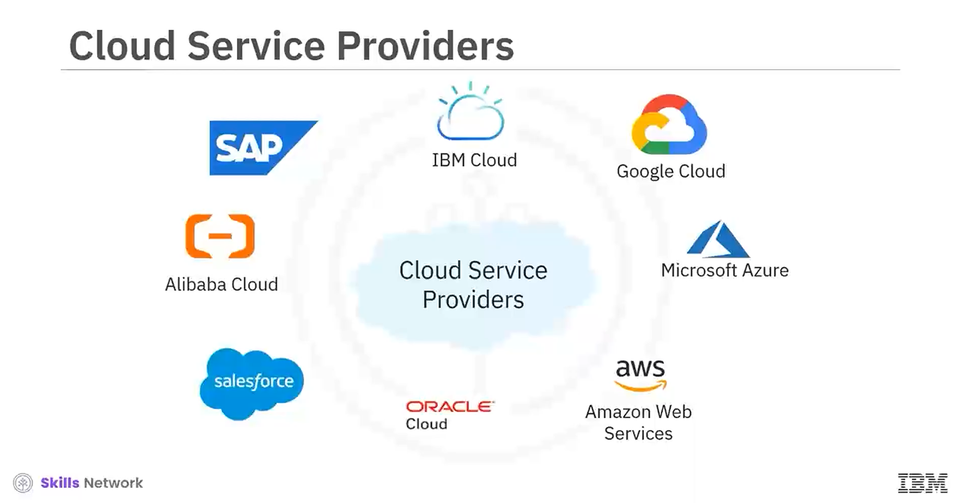

Slide 19
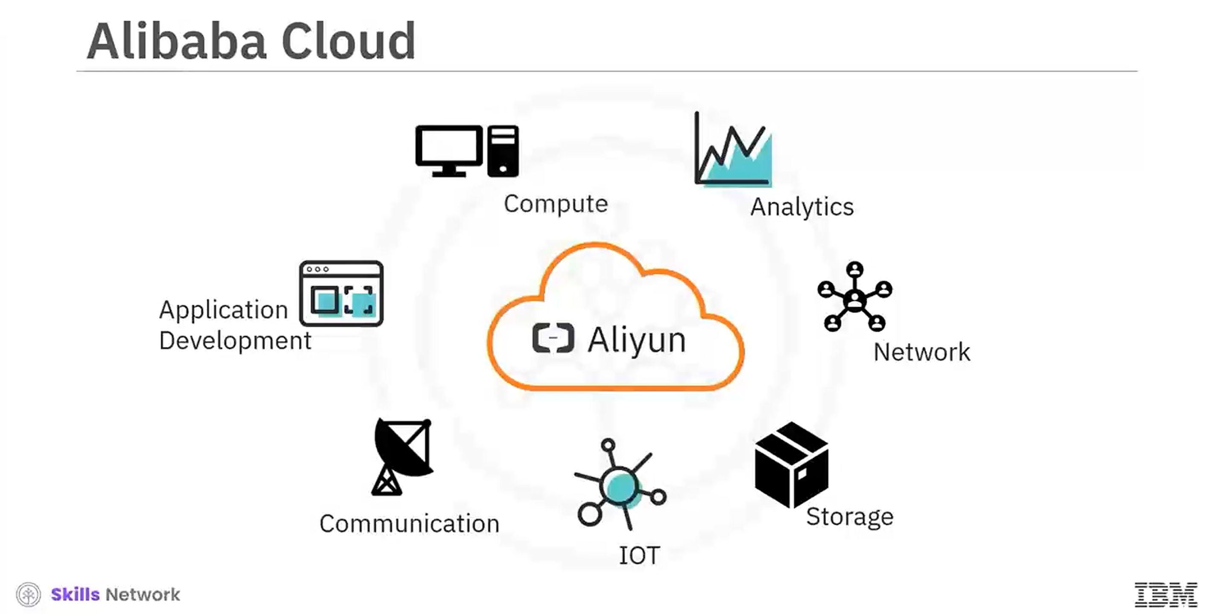

Slide 20
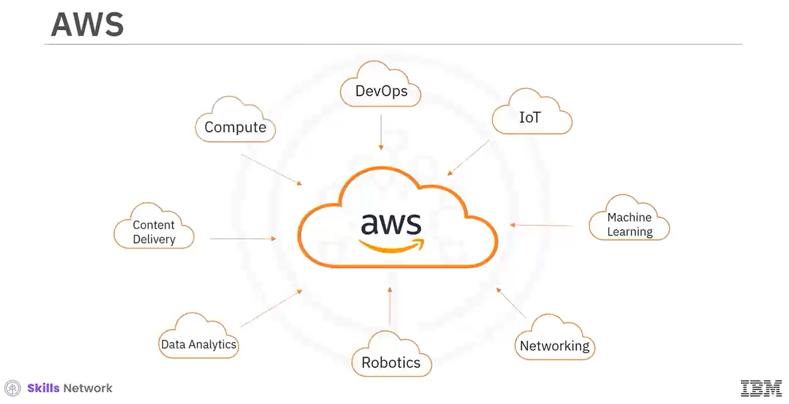

Slide 21
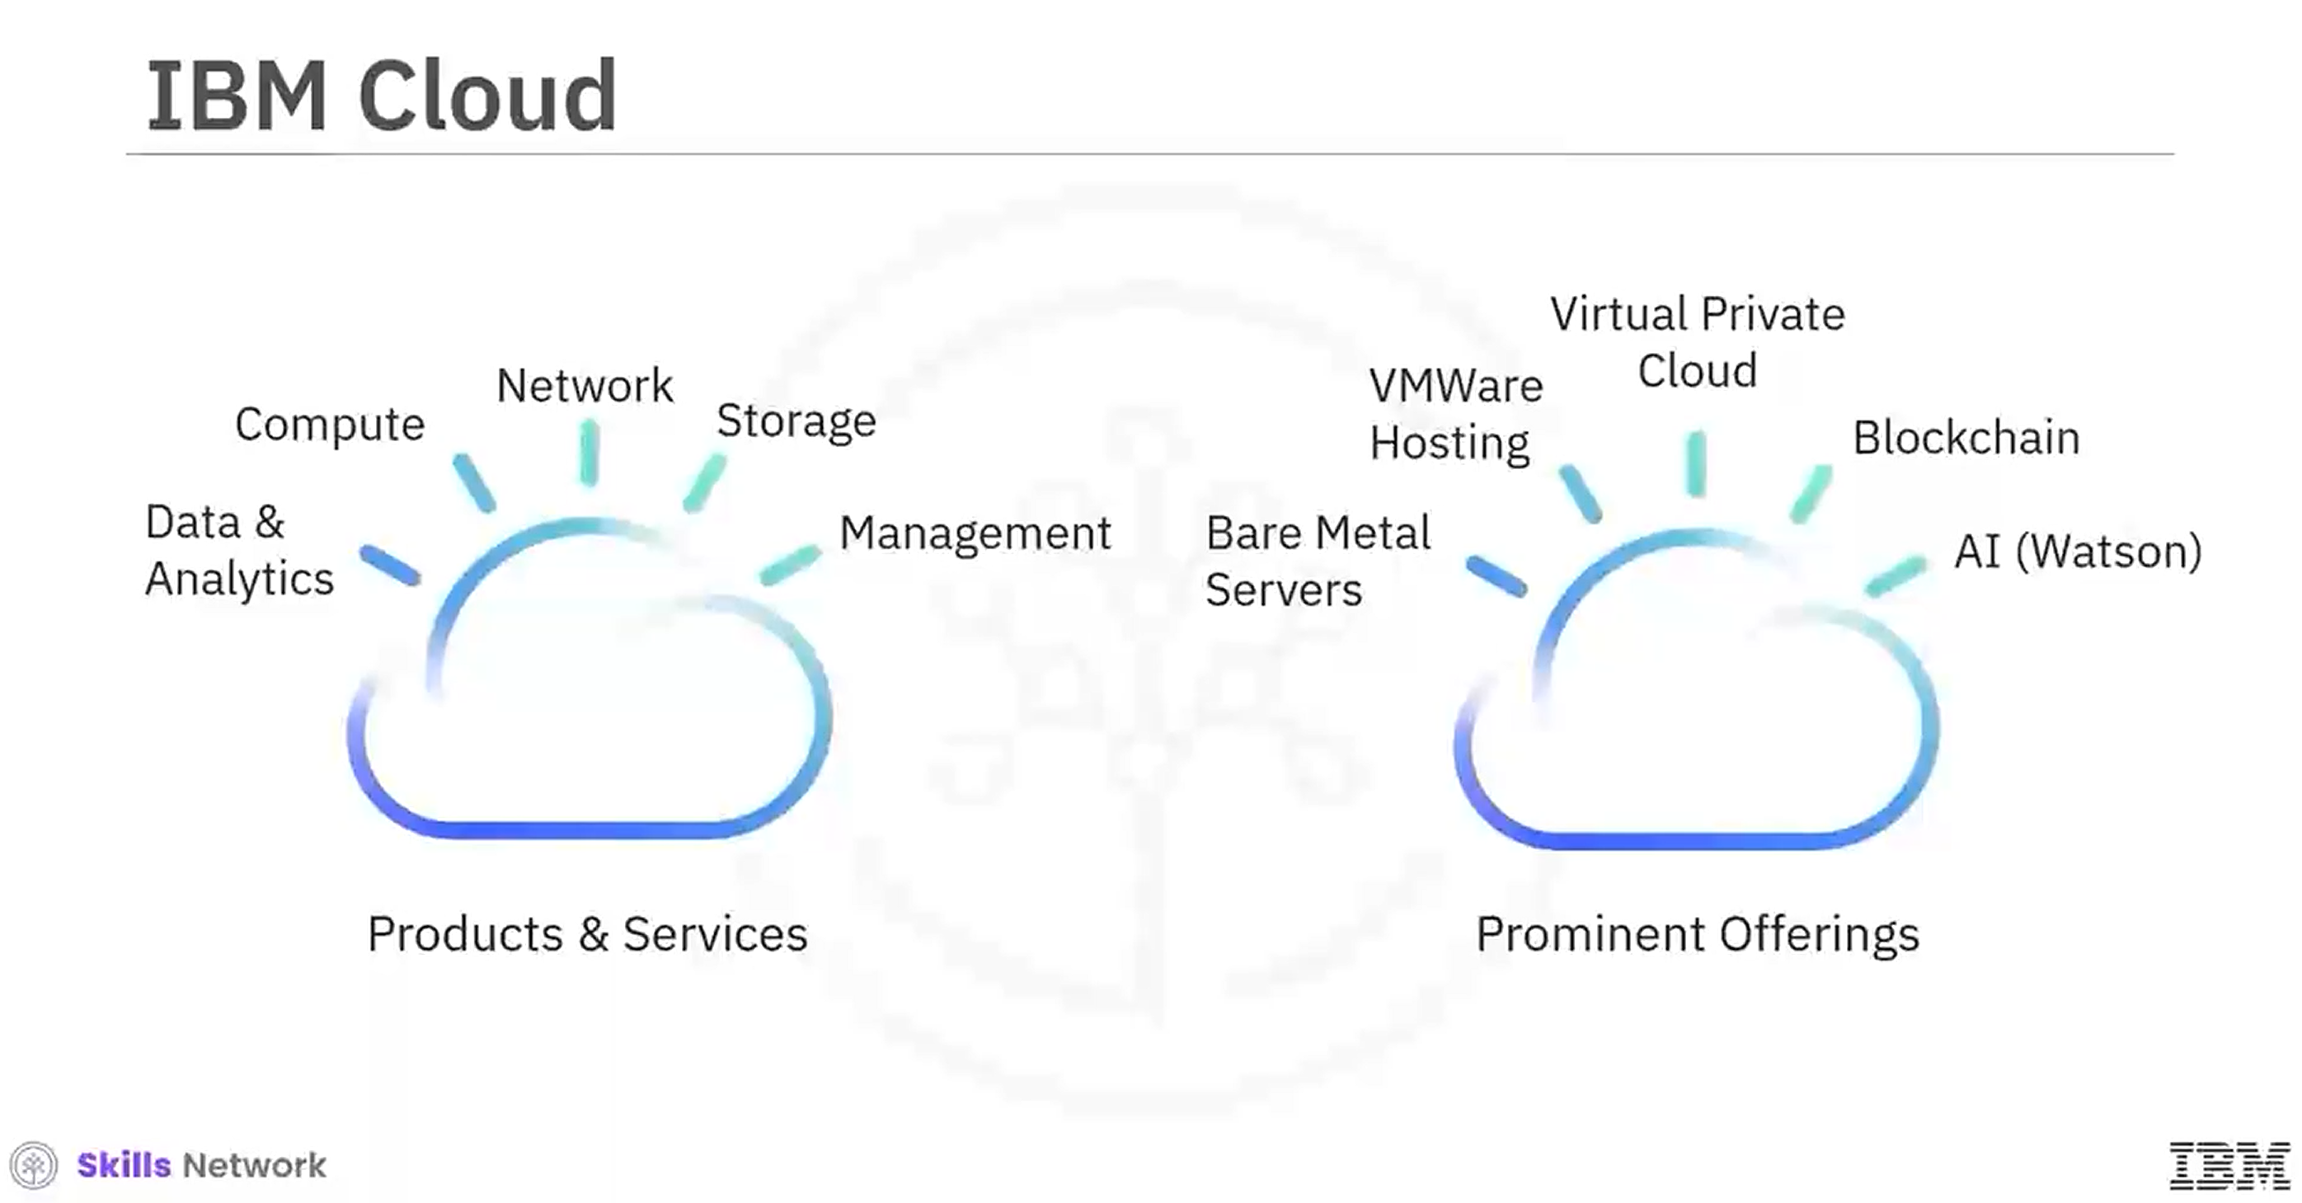

Slide 22
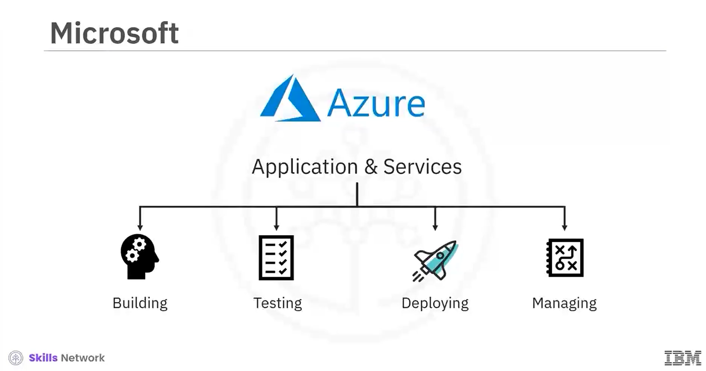

Slide 23
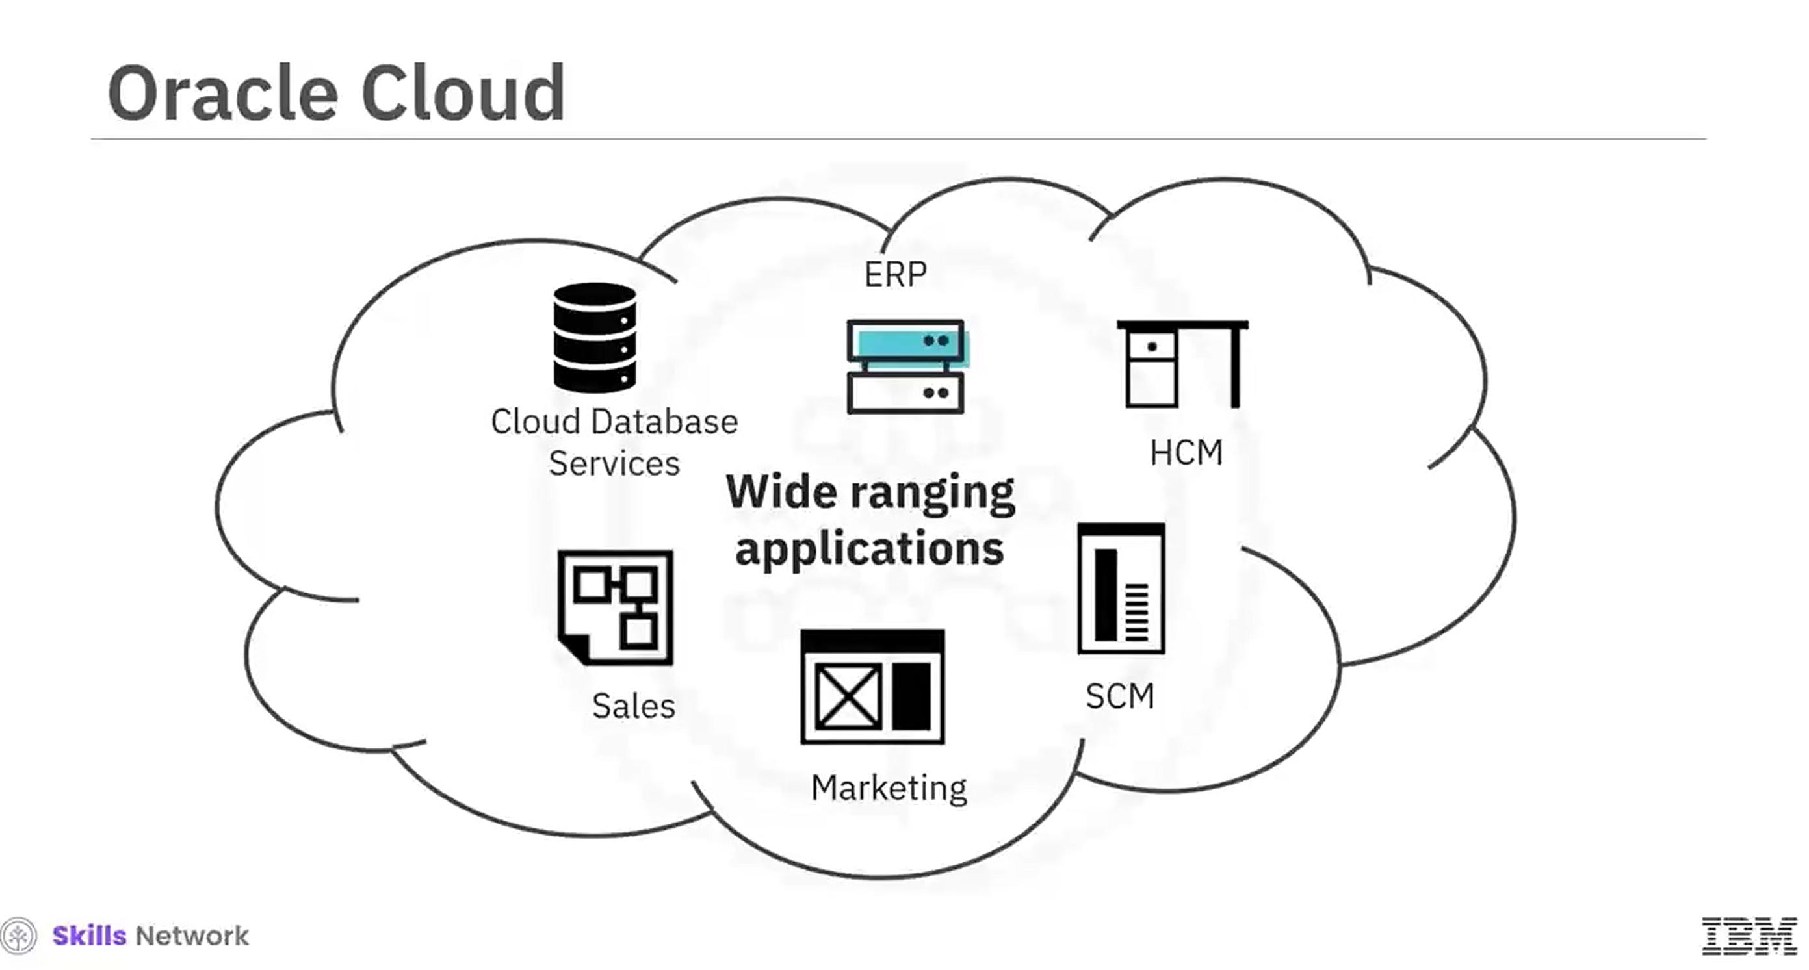

Slide 24
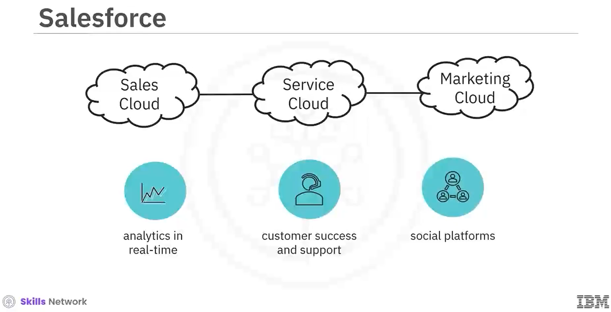

Slide 25
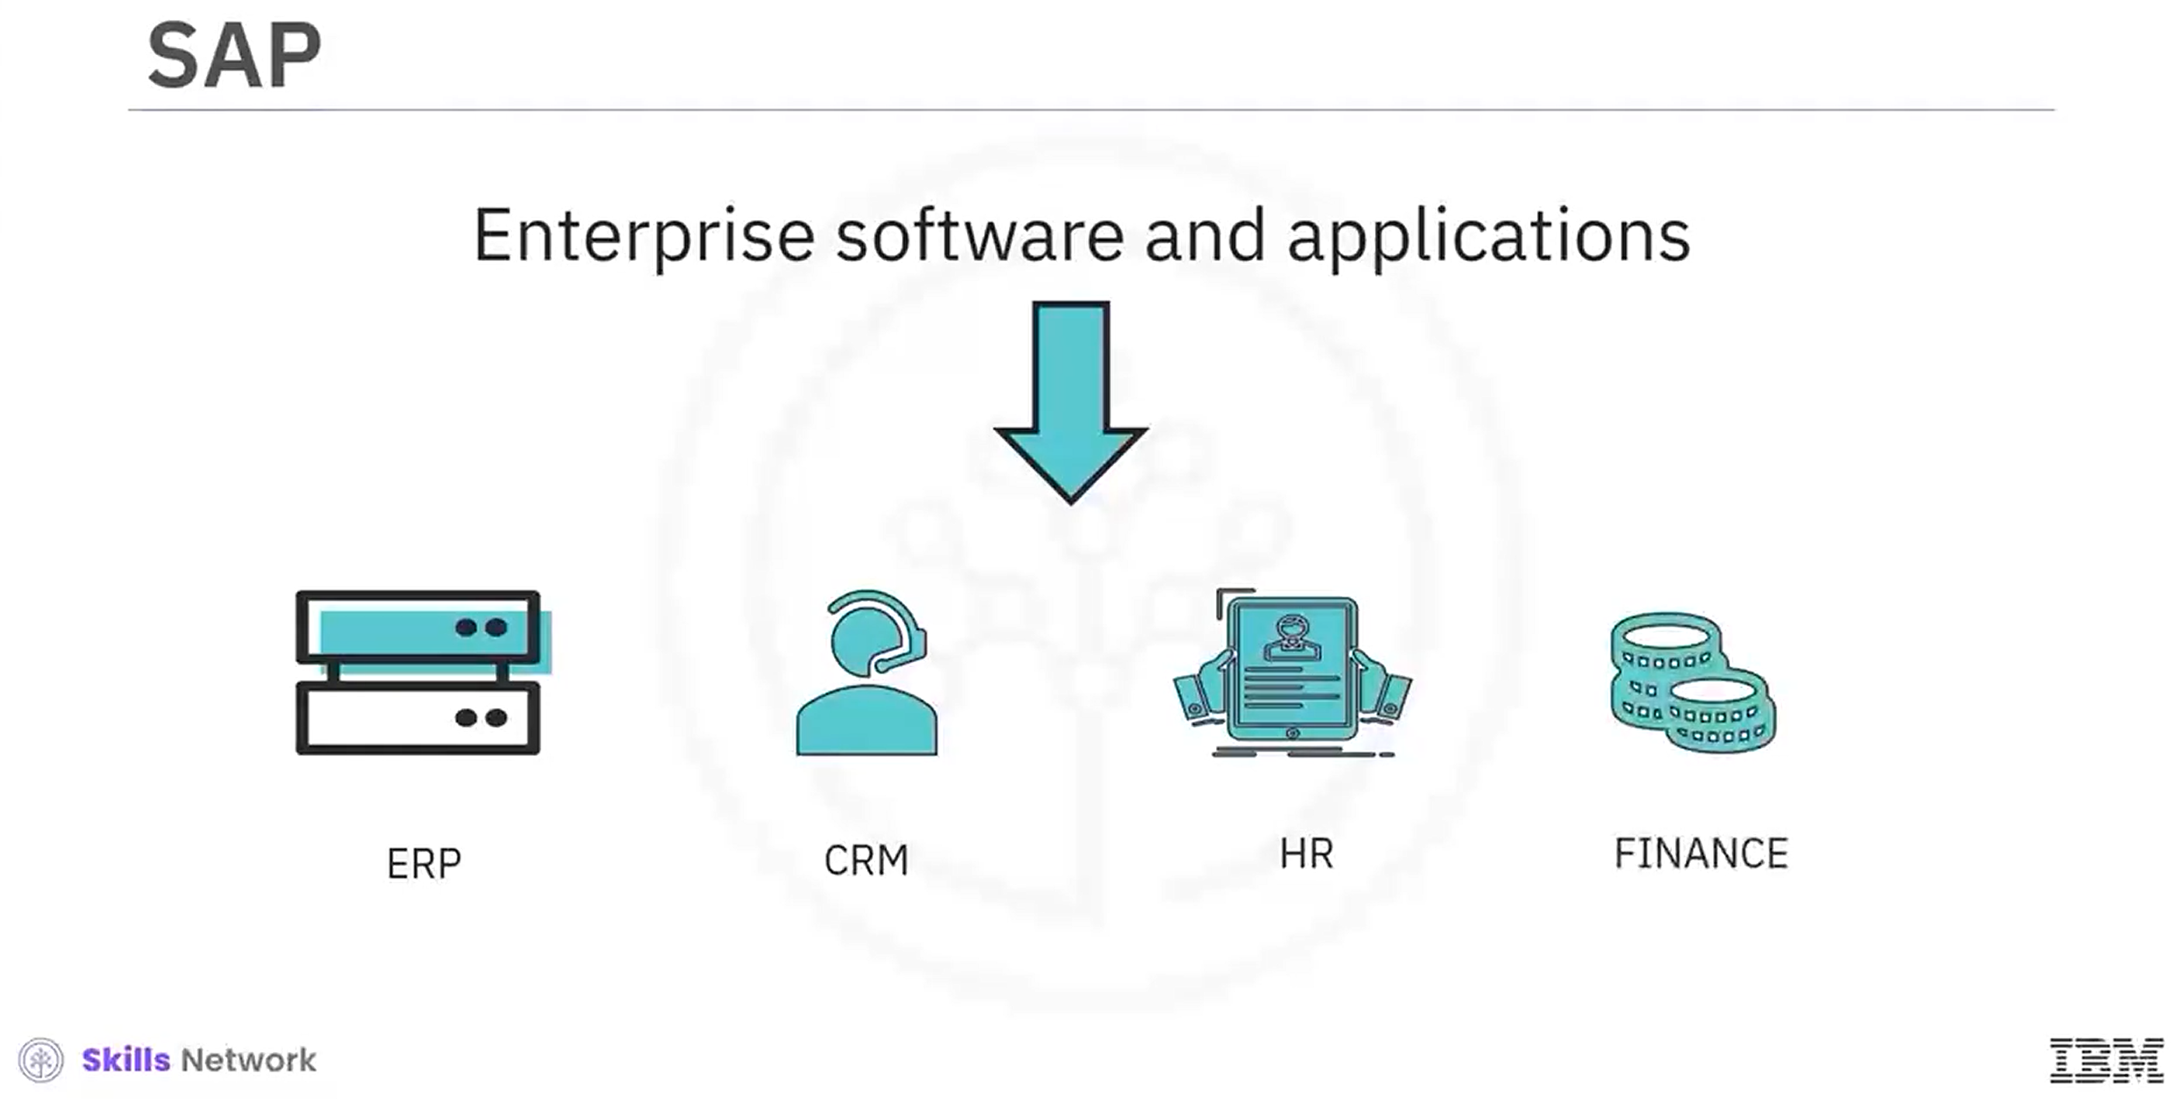

Slide 26
The Big 3
Provider | Number of Services | Availability Zones | Geographic Regions | Market Share
AWS | >250 | 108 | 34 | 31%
Microsoft Azure | >200 | 126 | 64 | 25%
Google Cloud | >200 | 121 | 40 | 11%
Notes:
“Amazon Web Services (AWS) has fewer geographic regions compared to some competitors due to its strategic focus on establishing larger, more comprehensive regions. Each AWS region typically comprises multiple Availability Zones, ensuring high availability and fault tolerance. This approach emphasizes robust infrastructure and service reliability over the sheer number of regions. Additionally, AWS's expansion strategy is influenced by factors such as customer demand, regulatory requirements, and the need to maintain consistent service quality across all regions.” CloudOptimo

Slide 27
NIST: Service Models
Software as a Service (SaaS): Consumers use applications hosted on cloud infrastructure through interfaces like web browsers. They don’t manage the infrastructure or the applications, except for limited user-specific configurations.
Platform as a Service (PaaS): Consumers deploy their own applications on the provider’s cloud infrastructure. They control the applications and some configuration settings but don’t manage the underlying infrastructure (e.g., servers, storage).
Infrastructure as a Service (IaaS): Consumers provision fundamental computing resources, such as processing and storage, to deploy and run software, including operating systems and applications. They have control over these resources but not the underlying infrastructure.

Slide 28
Shared Responsibility
Responsibility | On-Premise Responsibility | Infrastructure as a Service (IaaS) | Platform as a Service (PaaS) | Software as a Service (SaaS)
Applications | Customer | Customer | Customer | CSP
Data | Customer | Customer | Customer | CSP
Runtime | Customer | Customer | CSP | CSP
Middleware | Customer | Customer | CSP | CSP
Operating System | Customer | Customer | CSP | CSP
Virtualization | Customer | CSP | CSP | CSP
Servers | Customer | CSP | CSP | CSP
Storage | Customer | CSP | CSP | CSP
Networking | Customer | CSP | CSP | CSP

Slide 29
Cloud Computing Models (IAAS)
Definition:
Provides virtualized computing resources over the internet, including virtual machines (VMs), storage, and networking.
Users are responsible for:
managing the OS, applications, and security configurations.
Key Benefits:
Full control over the environment
Scalable resources (on-demand provisioning)
Supports various workloads (databases, web apps, analytics)
Examples:
AWS EC2 (Elastic Compute Cloud); Microsoft Azure Virtual Machines; Google Compute Engine (GCE)
Use Cases:
Hosting applications and websites
Running development & testing environments
Migrating on-prem workloads to the cloud

Slide 30
Cloud Computing Models (PAAS)
Definition:
Provides a fully managed development and deployment environment for applications without managing infrastructure.
Includes runtime, databases, and developer tools.
Key Benefits:
Reduces operational complexity
Automatic scaling and management
Accelerates development by handling infrastructure tasks
Examples:
AWS Elastic Beanstalk; Google App Engine; Microsoft Azure App Services
Use Cases:
Deploying web applications and APIs
Running containerized applications
Developing microservices-based architectures

Slide 31
Cloud Computing Models (Serverless)
Definition:
Runs code in response to events without provisioning or managing servers.
Resources are dynamically allocated and billed per execution.
Key Benefits:
No idle costs
Reduced management overhead (no OS, infrastructure, or patching)Ideal for event-driven workloads
Examples:
AWS Lambda; Google Cloud Functions; Azure Functions
Use Cases:
Event-driven processing (file uploads, database changes, API triggers)
Real-time stream processing (IoT, monitoring, chatbots)
Running lightweight microservices

Slide 32
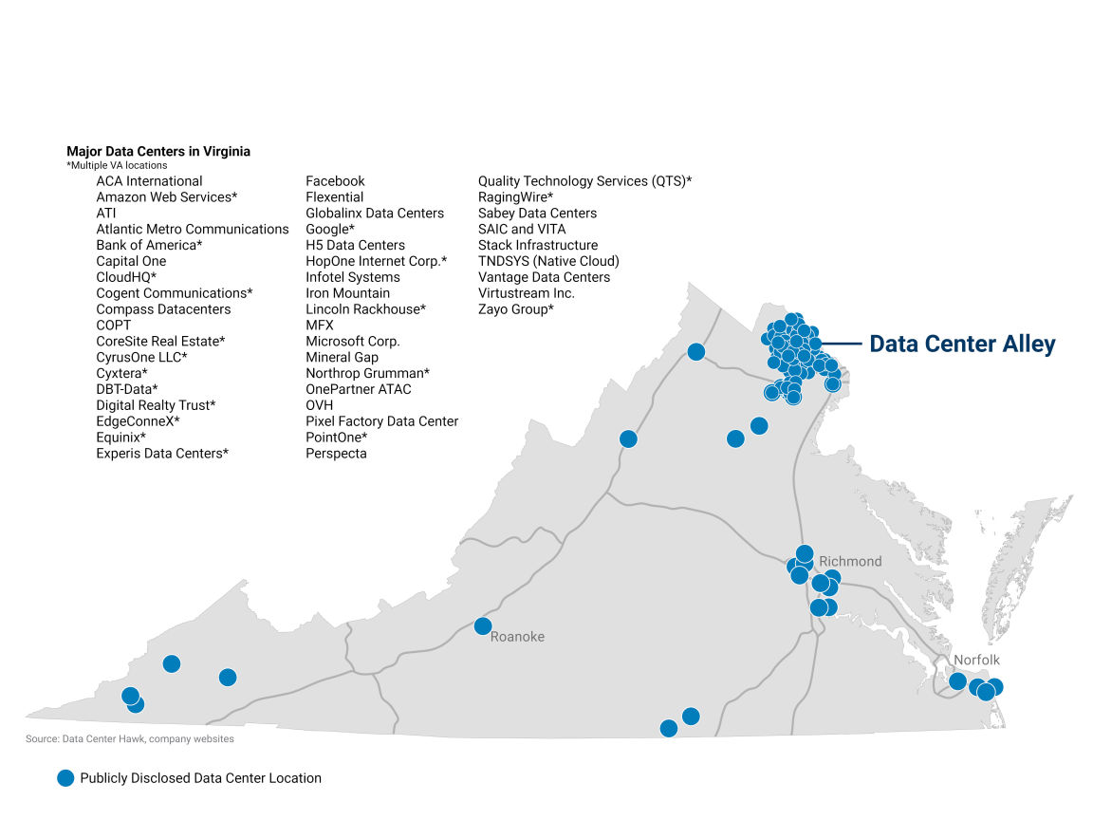
Exploring Cloud Infrastructure
Cloud Infrastructure Map

Slide 33
Cloud Geography
Regions
Geographic Security
Legal compliance
Availability Zones
Own power, cooling, network connections
Isolation improves fault tolerance and decreases latency
“Special” Clouds
Gov
DoD

Slide 34
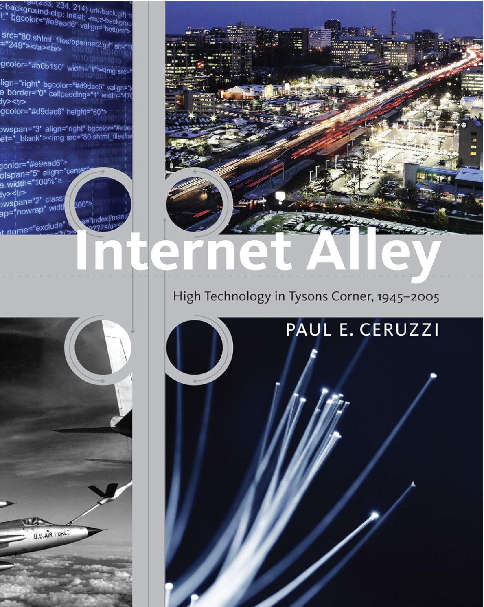
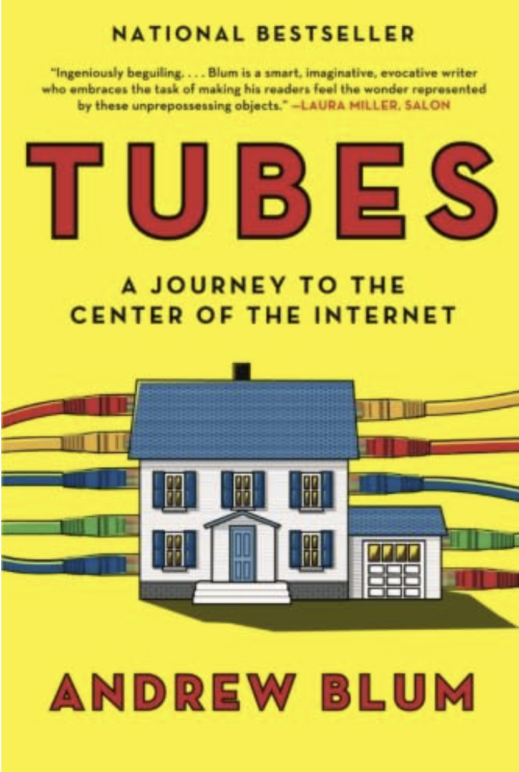
Two Recommended Sources

Slide 35
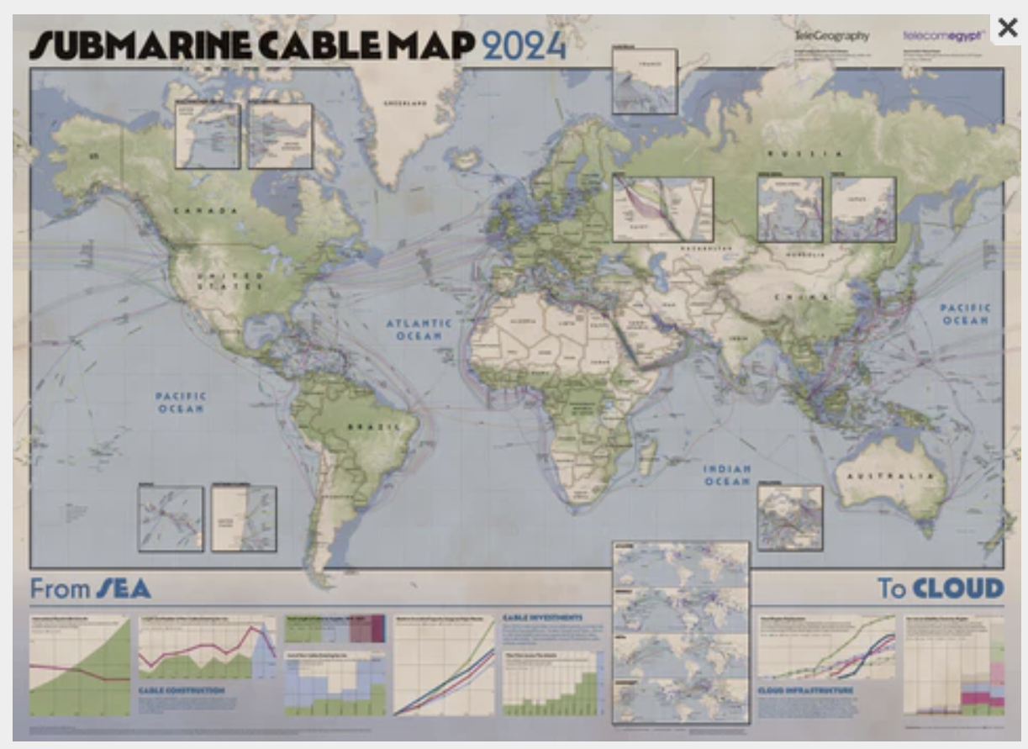
Telegeography
Undersea cables carry 95% of
intercontinental data traffic

Slide 36
Redundancy and High Availability
Multiple Data Centers
Multiple Regions
Data Replication
Load Balancing
Automatic Scaling
Backups and Snapshots
Fault Tolerance and Resilience
Disaster Recovery

Slide 37
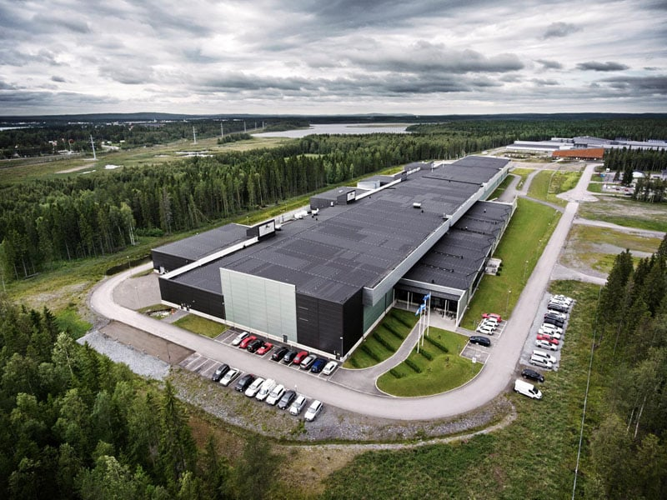
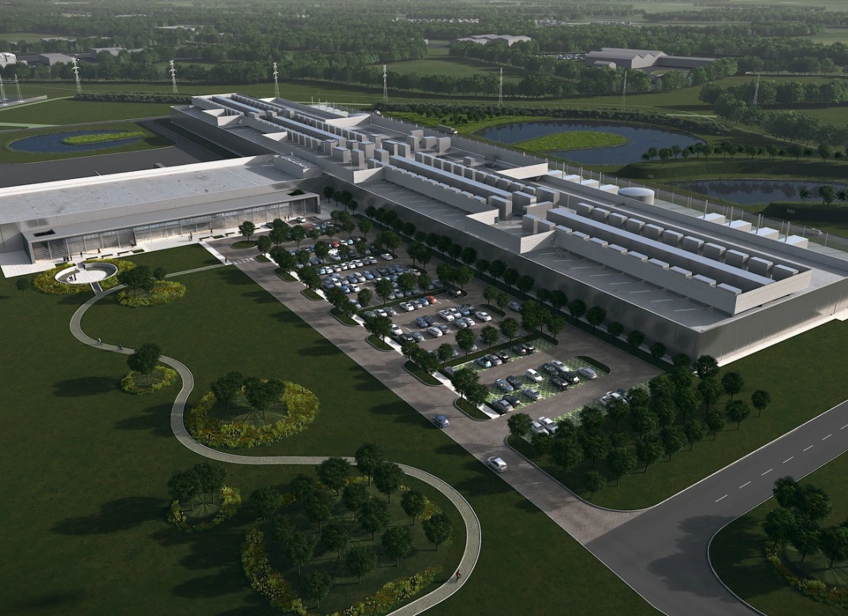
Physical Security
Separate Buildings
Restricted Access
Controlled environment
Fire suppression
Generators
Cooling
Disaster Resilience
Separate regions
High speed connections
Intra
Inter
Disposal and Decommisioning

Slide 38
Networking Infrastructure
Physical networks
High-speed cabling
Routers and switches
Software Defined Networks
Network resources are virtualized
Made available programmatically through APIs
Virtual Private Clouds (VPC)
Users must set up PUBLIC and PRIVATE interfaces
IP addresses
Subnets
Security Groups
Internal IDs: (Amazon Resource Names ARNs)

Slide 39
Online Infrastructure
Based on types of services provided to customer
Services work together to make interaction “easy”
Spin up/spin down as needed
Services designed to bring customers in
Vendor lock in?

Slide 40
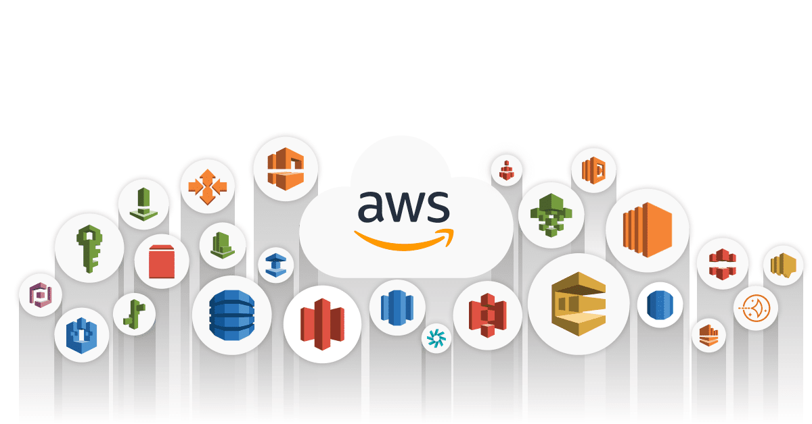
Service domains:
Compute
Migration
Storage
Database
Security, Identity, & Compliance
Networking/Content Delivery
Management Tools
Messages
Analytics
Machine Learning and AI
Internet of Things
Each with subsets of specific services.
This program will focus on compute, migration, storage, database, and security

Slide 41
AWS Compute Services for Data Engineering & Data Science
Amazon EC2
Virtual machines for general-purpose workloads, scalable and customizable.
AWS Lambda
Serverless compute that runs event-driven functions without managing servers.
AWS Fargate
Serverless containers, runs Dockerized applications without provisioning infrastructure.
AWS Batch
Fully managed batch processing for large-scale data workloads.
AWS Glue
Serverless ETL service for processing and transforming big data.
Amazon EMR
Managed big data processing with Spark, Hadoop, and Presto.

Slide 42
Storage
Simple Storage Service (S3)
Object-based file system
(BLOb)
Scalable and available for anything from website storage to data lakes and big data analytics
Stores all data as objects within buckets
Glacier
Low cost archiving service
Usually for data that isn’t accessed too often

Slide 43
Cloud Storage Services
AWS Service | Azure Equivalent | Storage Type
Amazon S3 | Azure Blob Storage | Object Storage
S3 Glacier | Azure Archive Storage | Cold/Archival Object Storage
EBS (Elastic Block Store) | Azure Managed Disks | Block Storage
EFS (Elastic File System) | Azure Files | Network File Storage

Slide 44
Database
Aurora
Relational database – compatible with other query languages
RDS
Relational database management service
Not a database itself, but handles updates, security patches, rollbacks
DynamoDB
NoSQL management service
Redshift
Warehousing service – fed data from RDS or DynamoDB

Slide 45

Migration
Data Migration Service (DMS)
Helps migrate databases into AWS
Supports any widely used source databases, commercial to open-source

Slide 46
Free Tier
AWS is NOT FREE!
Monitoring your services & utilizing free tier is a must to keep costs down
Most services we use in class are part of the introductory free tier
Allows 1 year of free usage
RDS, S3, EC2
As we progress in the course – free tier usage will be explained, however if you explore AWS on your own – BE CAREFUL

Slide 47
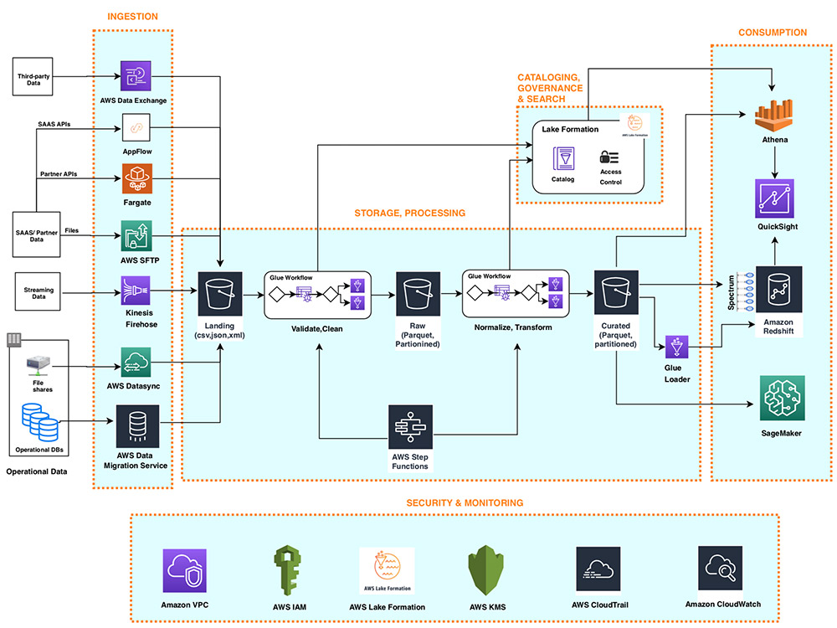
AWS Data Engineering Architecture
Here is an example of the type of services a data engineers utilizes to build pipelines within AWS. Many of these flows will be used in this course

Slide 48
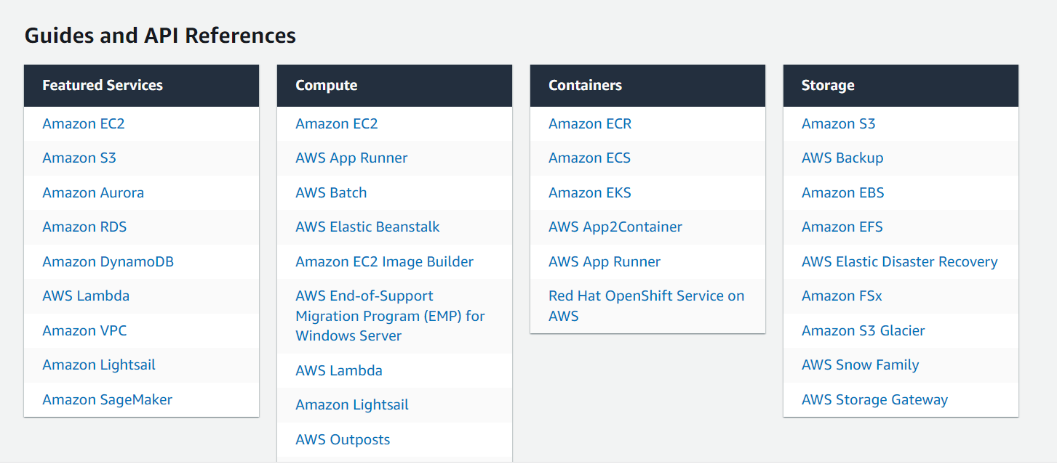
AWS documentation is key, solutions and tutorials are littered throughout the docs
When we learn new services – it is recommended that you dedicate some time to study the documentation

Slide 49

Making the Cloud Business Case
How to explain this to executives

Slide 50
Example Use Cases
Hosting dynamic websites on AWS
01
(Using EC2, S3, and Route 53)
Serverless data processing pipeline
02
(Lambda, S3, and DynamoDB)
Disaster recovery strategy using AWS
03
(EC2, S3, and Route 53)
Creating a data warehouse for big data analytics
04
(Redshift, Glue, and Quicksight)

Slide 51
Cloud or On Prem? What should businesses consider?
Costs
Capex vs Opex
Scalability
Security and Compliance
Control over systems
Employee skills
Reliability and availability
Deployment speed
Maintenance
Innovation
Data Sovereignty
Integrations
What about Hybrid?

Slide 52
Controlling Costs
Right Sizing
Elasticity
Spot instances or preemptible VMs
Reserved instances
Delete unused resources
Storage tiers
Minimize data transfer into the cloud
Use the tools available!

Slide 53
Cost Categories
Capital Expenditure (CAPEX):
Involves spending money upfront on physical infrastructure.
Costs include servers, storage, network equipment, backups, disaster recovery, data center expenses, and technical staff.
Requires estimating and committing funds upfront.
Operational Expenditure (OPEX):
Involves costs passed to the service provider, with the customer paying only for non-physical expenses.
Costs include software leasing, employee training, cloud support, and billing based on cloud usage metrics (e.g., compute, storage).
Allows trying services without large initial investments in equipment.

Slide 54
Challenges of Cloud Adoption
Cost Management & Optimization
Cloud costs can spiral out of control without proper monitoring.
Requires cost governance, budgeting, and right-sizing resources.
Security & Compliance
Data breaches, access control, and regulatory compliance (GDPR, HIPAA, SOC 2).
Shared responsibility model means businesses must secure their own data.
Performance & Latency Concerns
Latency issues arise if cloud data centers are far from users.
Network bandwidth limitations impact real-time applications
Vendor Lock-in
Difficult to migrate workloads between cloud providers.
Proprietary services make multi-cloud or hybrid strategies complex.
Skill Gaps & Organizational Readiness
Requires training and hiring cloud-skilled engineers.
Many companies struggle with cloud-native mindset adoption.

Slide 55
Takeaways
Organizations have been experimenting “cloud-like” technologies for a long time
Cloud methods allow providers to specialize and offer robust services
Cloud technologies aren’t just “someone else’s computer”

Slide 56

Next Week
Cloud Services and
Data Engineering

